Slide 1


Notes:
Introduce yourself! Explain that you work in the Contextual Admissions team at the University of Leeds and that you are going to talk about the Access to Leeds scheme.

Slide 2
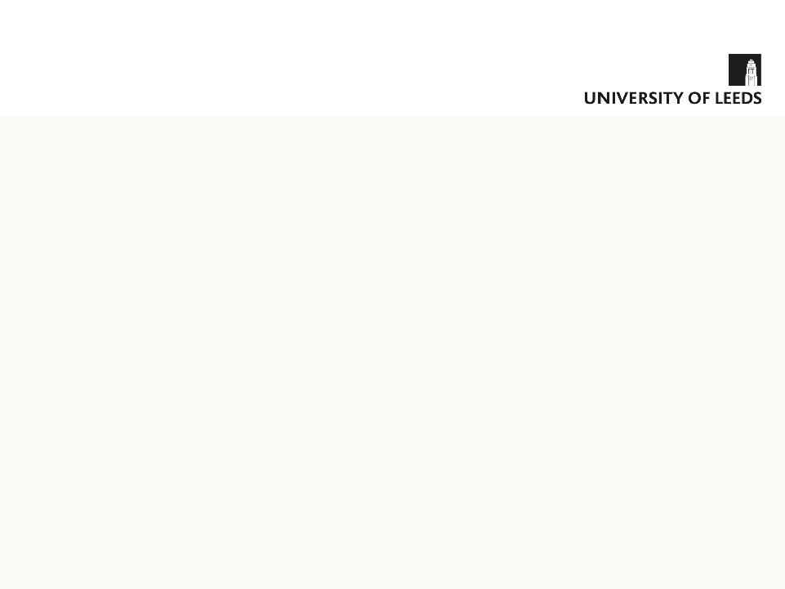
Today’s Talk
What is Access to Leeds?
Access to Leeds Eligibility
How and when to apply
Notes:
Go through the points!

Slide 3

What is Access to Leeds (A2L)?
University of Leeds’ alternative admissions scheme
Includes all undergraduate courses
Gain special consideration from admissions tutors – may result in a lower offer
Aim to recruit the best and brightest students regardless of background
To encourage a socially diverse student community
Notes:
What is Access to Leeds?
It’s the University’s alternative admissions scheme, also called contextual admissions scheme, or widening access scheme.
The scheme applies to all undergraduate courses and guarantees special consideration on your application to the university if you meet certain criteria, relating to your personal circumstances.
This can give you an opportunity to receive a reduced offer on the standard entry requirements.
So why do we do it? We want to recruit the brightest students, but at the same time we recognise that there is sometimes a wider context around someone’s academic achievements (basically your exam results) and that your grades don’t necessarily tell us everything about an you as an individual
We also want a university with a truly diverse mix of students that represents the society that we live in. We do not believe that any factors in a student’s background should be a barrier to them applying to university.

Slide 4

Are you Eligible for Access to Leeds?
First generation of your immediate family to go to university
From a household with an annual income of up to £25,000:
Received free school meals during your GCSE studies OR
In receipt of 16-19 bursary fund OR complete Declaration Form
School achieved below the national average GCSE results
Live in a geographical location with low progression to HE (by postcode)
Studies disrupted by circumstances in personal, social or domestic life
Only HE option is to study at a local university
Living in or have been brought up in public care
Notes:
(There are animations on this slide, so click one point at a time. Go through each point, expanding on the info as required)
I’m going to through the eligibility criteria for Access to Leeds. So, if you meet two or more from this list, you should be eligible to apply for the scheme.
If you are in the first generation of your immediate family to go to university – by immediate family, we basically mean your parents – if brothers or sisters have gone to uni, this is fine.
The next criterion is a financial one. If you come from a household with annual income of £25,000 or less – so you may need to ask your parents about this one. You can demonstrate this in a number of ways: if you received free schools meals during your GCSE studies, OR if you receive the 16-19 bursary in sixth form, or Learner Discretionary payments – with an income threshold of £25,000. If neither of these apply, to can submit a declaration form – this will need to be completed and signed by the main income earner in your home.
If you went to a school which achieved below the national average for GCSE results. To check this we use the Attainment 8 score from the Department for Education website. This will apply to the school where you sat your GCSE exams, and checked for the year in which you sat them.
If you live in an area which has ‘low progression’ to Higher Education. This measure uses government data based on numbers of people going to university in your particular area. You can easily check if you would be eligible by entering your postcode into the postcode checker on our website (can demonstrate via link)
If your studies have been disrupted in some way because of personal circumstances. This can cover a whole range of things, but could include things like health or medical conditions or serious illness or accidents, bereavements, disruptive family circumstances, serious personal issues, serious illnesses of family members or caring for family members – any really if you feel that you can demonstrate that the situation has adversely affected your studies and will need to tell us about it on your application. Your referee will also need to be aware of the situation and will need to provide verification on their reference.
You may meet the next criteria if you are only able to apply to universities that are close to where you live. By close, we mean within 90 mins travel by public transport. By your ‘only option’, we don’t mean that this is a preferred option, but that you have to stay at home or close to home for reasons such as caring for a family member or that have a medical issue and need to attend hospital. We cannot include financial reasons for this, so you can’t say that you can’t afford to move out of home, because we already have a financial criterion.
The final criteria – if you have lived in, or spent any time in care while growing up.

Slide 5


Why apply to Access to Leeds?
Opportunity to receive an A2L course offer
Take part in the A2L module
Helps students with the transition to university
Gain university tuition before the start of your course
Participate in on-campus events
Additional consideration for scholarships
The Plus Programme
Notes:
So, why apply to Access to Leeds?
The main reason why people apply to the scheme is the potential to receive a lower offer. So if you have made an application through UCAS to any undergraduate course at the university of Leeds and meet the Access to Leeds criteria, you are guaranteed to receive special consideration on your application – this means you can receive a reduced offer that is typically 2 A Level grades below the standard offer you will see advertised – I’ll show you what this might look like in a minute.
As part of the Access to Leeds programme, you will complete our academic module –I’ll talk more about this shortly.
Access to Leeds also supports students with the transition from school or college into university – this can be a really big step and we want to help prepare students for higher education. The module helps you develop the skills that you will need to succeed as an undergraduate student and give you a bit of an introduction to the subject area you are applying to study. The team is also available for general support and advice throughout the whole process of applying to university, up until getting your exam results and beyond.
When you take part in the module, you will have contact with a university tutor who will support you in completing an assignment.
You will also be invited to take part in events on the campus, so you’ll find out more about the university and get a feel for the place
I already talked a bit earlier about scholarships – so if you successfully complete Access to Leeds, you can receive extra consideration if you’ve applied for scholarships – a significant number of Access to Leeds students do receive a scholarship each year.
Once you start at university, you will automatically be a part of our Plus Programme – this is extra support that is available throughout your time as a Leeds student – I’ll talk a bit more about this later.

Slide 6
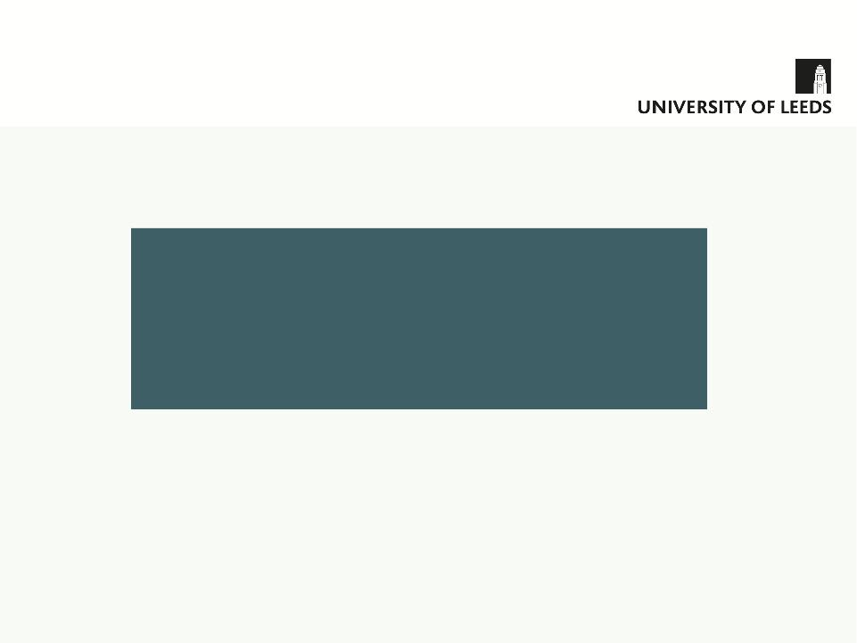
The Access to Leeds offer
Successful applicants usually receive a standard offer and an alternative offer.
Example:
To keep the A2L offer applicants must:
Complete and pass A2L module
Make University of Leeds firm UCAS choice
**A2L does not guarantee an offer**
Radiography (BSc)
Standard Offer: ABB (A Level)
A2L typical offer: BBC
For BTEC – UCAS points equivalent. e.g. DDD->DDM
Notes:
So what is the Access to Leeds offer and what does it look like?
If the Admissions tutors have assessed your UCAS application, along with your application to Access to Leeds and decide they want to make you an offer, you will usually receive a standard offer and an alternative offer.
I’ve given the example of Radiography, which was a really popular course last year. The standard grades that are advertised on the website and in the prospectus are ABB. The Access to Leeds offer would reduce that by two A Level grades, so it would be BBC. If you are taking BTECs, the equivalent in UCAS tariff points would be applied. In most cases, you would get the standard offer, and the alternative offer alongside it, and it will appear on your UCAS Track
Part of the conditions of receiving your reduced offer will be to complete and pass the Access to Leeds module. You will also make Leeds your Firm choice when you make your Firm and Insurance choices with UCAS.
It’s important to be aware that Access to Leeds does not guarantee that you will receive an offer, but it does mean extra consideration, which essentially means so could still be considered if you might not quite meet the standard entry grades.

Slide 7


Access to Leeds Module
Distance learning via University ‘Minerva’ Service
Prepare for university study, get a head start
Study Skills Exercises
Online activities
Key skills for university study
Assessed by multiple choice questions
Subject Specific Assignment
Set by tutor from your course
Contact with tutor throughout
Access to online library and resources
Notes:
So what is the A2L module, and what does it look like? (The slide has transitions that you can click through)
It’s an online module delivered via the University’s Virtual Learning Environment – this is the University’s online learning platform – you may have used something similar at school / college, like Moodle or Blackboard. The module is designed to help you prepare for university study and help you develop some key student skills. You’ll become familiar with the online environment and some of the university’s systems and procedures, so you’ll get a bit of a head start
There’s two parts to the module, (click to reveal) the first part is called Study Skills – it’s a series of online workshops and exercises designed around developing the skills that will really help in university study. It’s pretty straightforward and it’s assessed by multiple choice questions.
You will have six weeks to complete it and we suggest two hours per week is enough to complete this section.
As long as you successfully complete the first part of the module, you will go on to the second section – (click to reveal) the Subject specific assignment – this will be related to what you are hoping to study. It’s a taster of the subject – and is generally an essay 1250 words, the title being set by a tutor from the department you have applied to. There are a few exceptions – some subject areas have a set of online tests to complete, or it could be a mini-project. You will be able to communicate with the tutor throughout the assignment, ask them questions and have them feedback on a draft of your work . You will also have access to the University library, so you will get a taster of what academic learning resources are like.
The module is delivered between April and July of your year 13. Therefore you must be available and have internet access during this time. With a very small number of exceptions, the module is entirely online, so you do not need to come to the university to complete it. We are fully aware that this time overlaps with your exams – but don’t panic! The module is not too much work and is designed to fit around your study commitments and you will learn to manage your time effectively. It is not generally an issue for students to complete the module and we have an extremely high pass rate! 93% this year.

Slide 8
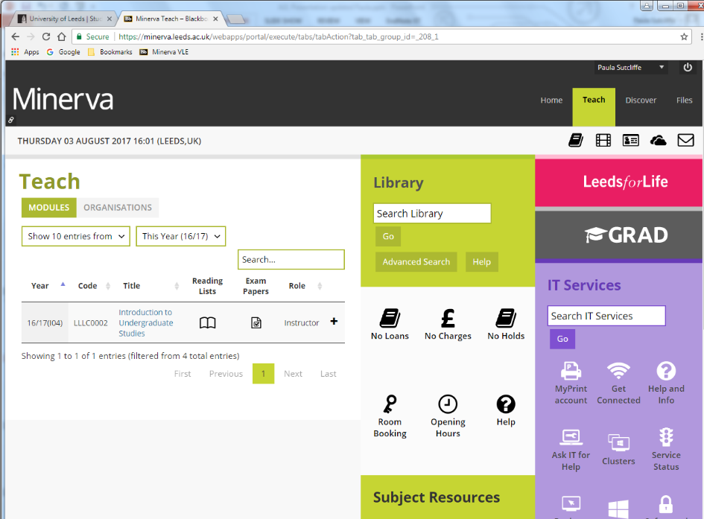
Notes:
So this is what our VLE looks like - it’s called Minerva and you’ll get your own login details to access it. The name of the Module is Introduction to Undergraduate Studies.
You can also access the online library catalogue here – literally hundreds of thousands of online resources!

Slide 9
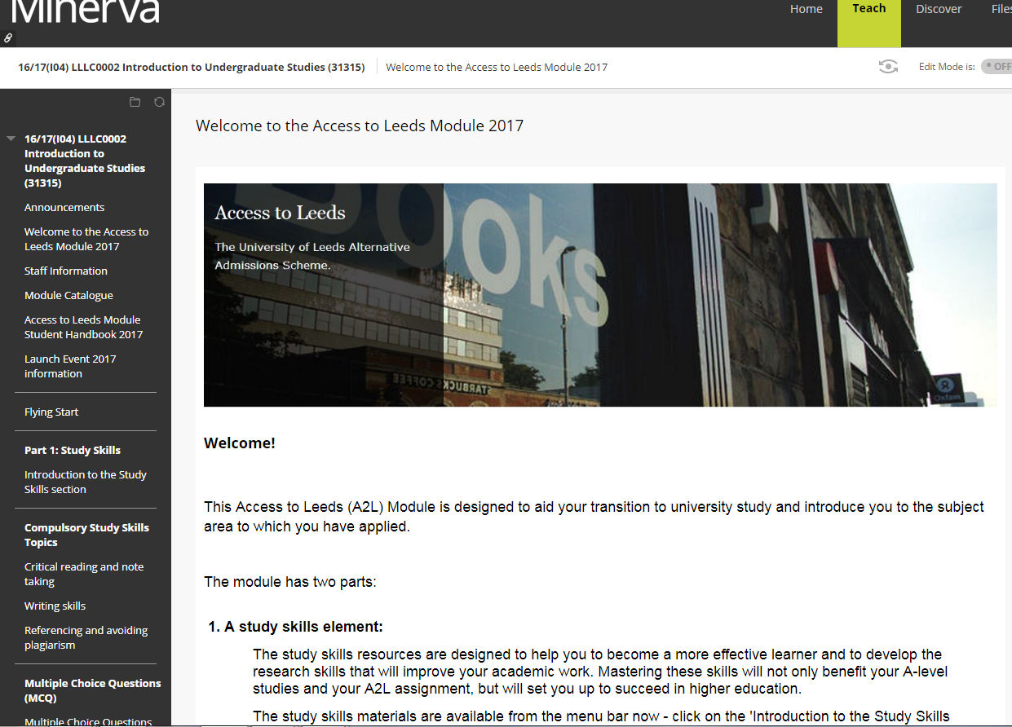
Notes:
These are the Study Skills topics – you’ll work on things like critical reading and note taking, writing academically, and learn how to reference and avoid plagiarism.
The exercises are all interactive – there are activities to work through, bits of information to read, videos to watch…

Slide 10
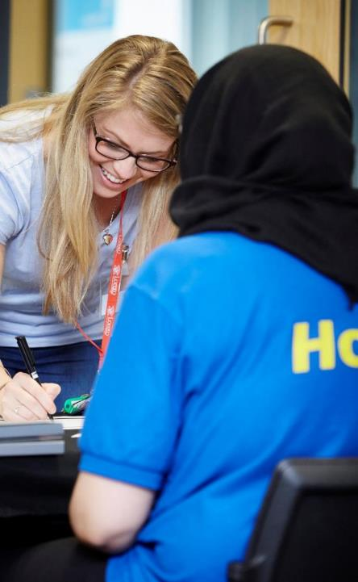
Access to Leeds events
April – A2L Launch Event
Meet current students and staff
Meet other A2L students
Further A2L and module information
September – A2L Welcome Event
Celebrate obtaining a place at the University of Leeds
Meet other students from your course
Make new friends!
Visit University student facilities
Notes:
During the Easter Holidays in March / April, we’ll have our Launch event, and will be to coincide with the start of the module. You’ll find out more about the module and what’s expected of you. You’ll get to meet our lovely staff team and current university students and ask them any questions you might have, and you’ll also get to meet other people doing Access to Leeds from all across the country and get a bit more familiar with the Leeds campus.
In September we’ll be having our Welcome Event – a bit of fun, celebration and congratulations for you gaining your place at Leeds. It’s also a chance for you to meet other students from your course and hopefully make some friends before term actually starts – all just before the crazy-busyness of Freshers’ week! There’ll also be an opportunity to find out more about life at University, start to settle in, and ask any final questions you might have before your big move!

Slide 11
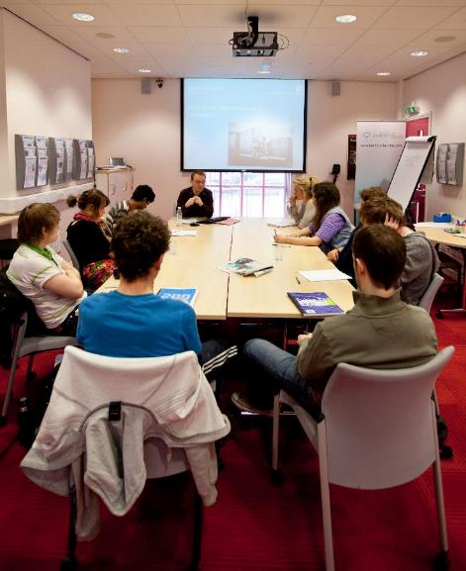
The Plus Programme
Exclusive on-course programme
Supports students throughout time at University
Focuses on:
- Transition and settling in
- Student success – academic and personal
- Employability and careers
Make the most of your time at Leeds!
Notes:
The Plus Programme is our exclusive on-course support programme for all students who have come through the Access to Leeds scheme. We recognised that students felt very well supported throughout participating in Access to Leeds, so wanted to continue to offer additional support once they arrived at the University. For some students, the transition from school or college into university is a big leap and they may need a bit of extra help to get the best out of their time at Leeds, so we offer the Plus Programme all the way through from Freshers’ Week to graduation.
The Plus Programme focuses on three main elements: The transition into uni and settling in; student success, so this includes both academic and personal success; and then employability and careers. It’s all there to help students make the most of their time at Leeds.
It’s all completely voluntary, so if you don’t need any additional support or guidance you don’t have to take part.

Slide 12
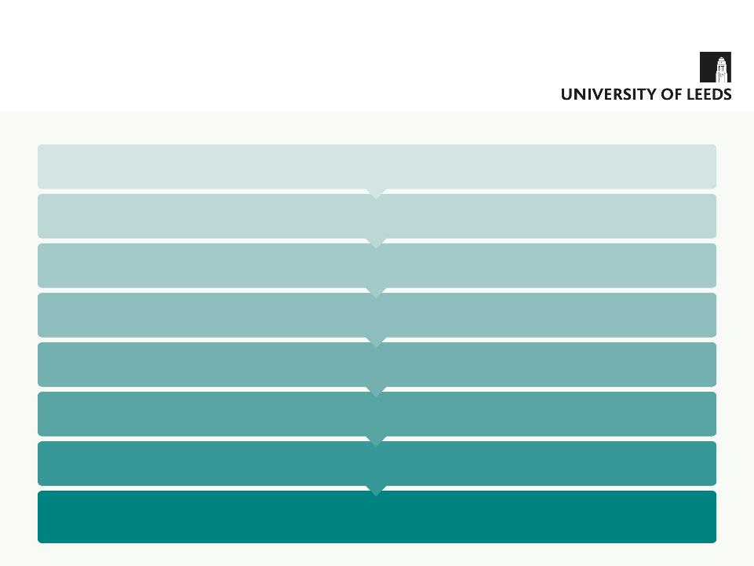
Access to Leeds Application Timeline
Mid – late September 2018: Access to Leeds applications open
September – February 2018/9:
Apply to UCAS – Submit A2L application - Admissions tutors informed – Receive special consideration and offer decision
5 November 2018 and 25 February 2019: Access to Leeds application deadlines
End March 2019: Access to Leeds module launched
April 2019: Access to Leeds events on campus – Begin working on module
Mid July 2019: Access to Leeds module deadline
Mid August 2019: Receive results of A2L module, A Level results day
September 2019: Welcome event for successful students!
Notes:
(There are animations on this slide, so click one point at a time)
So, this is a Timeline of the full Access to Leeds process.
- Applications will open towards the end of September – probably 25th
Applications are accepted from September until the end of February. You will do your UCAS application, then around the same time, or shortly after, submit your Access to Leeds application. You’ll then receive your offer decision.
There are two deadlines for sending your application – an early November deadline for anyone applying to Medicine and Dentistry courses and end of February for all other courses.
At the end of March, we launch the Access to Leeds Module
We’ll have events on campus at the start of the module and then students begin working on the module
The module then runs until mid July (with a two week break at the end of May between the two sections)
We’ll send you the results of the module just before A Level results come out in August.
Then, in September, we will welcome successful students to the university.

Slide 13

Applying to Access to Leeds
Visit the A2L website to apply online.
Student and referee complete application.
Submit after UCAS application.
Deadlines
 | Medicine and Dentistry | All other courses
UCAS | 15 October 2018 | 15 January 2019
Access to Leeds | 5 November 2018 | 25 February 2019
Notes:
So, to apply to the scheme, you need to visit our website and complete our application form. There’s a student section to complete and then you will need to send it to a tutor or member of staff at school / college who will act as a referee and complete their section. The form is then submitted to us online. You need to complete your UCAS application first, as you will need a UCAS ID to be able to submit for A2L application.
A reminder of the deadlines…

Slide 14
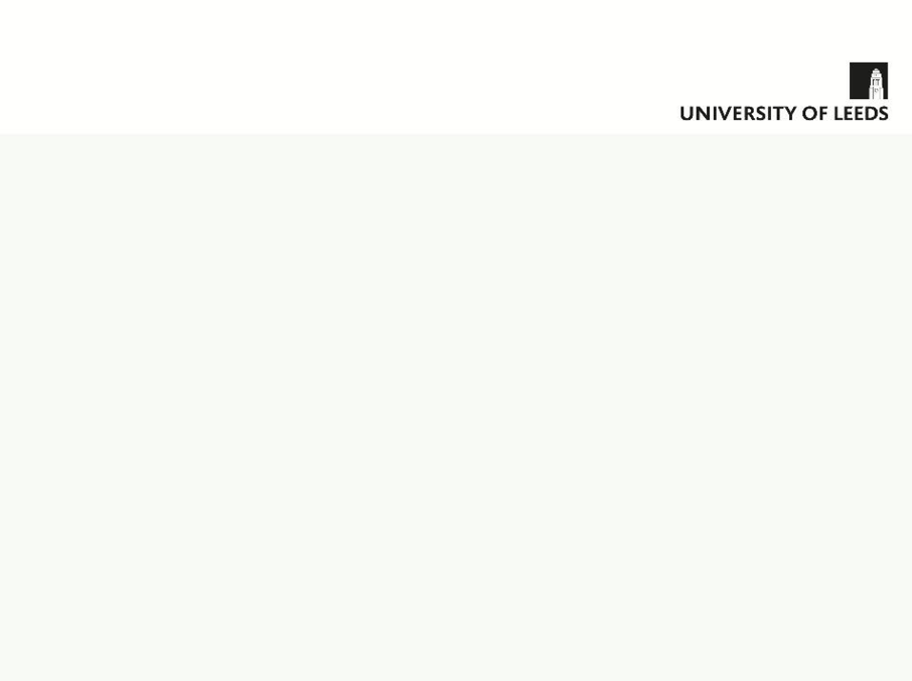
“I felt overwhelmed by the process of applying to university – I didn’t know anyone planning to study the same course as me. I am really pleased to have taken part in the scheme because it allowed me to access lots of support which helped me through the process.”
Florence Mutlow
MBChB Medicine
“Neither of my parents went to university so I knew Access to Leeds was right for me, because it would make me feel more confident about applying.
I really enjoyed meeting other students from the scheme and it meant that I would already know people from a similar background to me before I arrived at university.”
Joe Shakespeare
BA French
Notes:
I’ll just leave you with a couple of quotes from some of our Access to Leeds students. This is Florence, she’s a 4th year Medicine student – she’s also our Access to Leeds cover star, so you’ll see her face on all our leaflets and posters! I’ll let you read what Florence had to say…

Slide 15

Further Information
Visit www.leeds.ac.uk/A2L for more information and to complete an application
Contact the Access to Leeds team:
Tel: (0113) 34 38952
Email: accesstoleeds@leeds.ac.uk
Follow us on @accesstoleeds
Notes:
Here are our contact details if you need any further information
Website for applying
Phone number or email for any queries
And please follow us on Twitter!

Slide 16

Thanks for listening!
Notes:
Finally thank you very much for listening, and does anyone have any questions?

